Slide 1
Smart brushing pattern monitoring system
Technology fair project

Slide 2
Agenda
Overview
Architecture
Hardware
Software Programming
Benefits

Slide 3
Overview
Prototyping with Arduino Boards to find the number of minutes you are brushing.
This can be extended to various other applications such as pushing data from a thermostat or a light intensity resistor to a database server.

Slide 4
Items Required
An Arduino board
An Ethernet shield
USB cable type-B
RJ45 cable (Ethernet cable)
Ultrasonic Range Finder
A solderless breadboard
A few jumper cables

Slide 5
Software required
In order to accomplish this project, one should know how to program in:
PHP
SQL
HTML
CSS
JavaScript
C++

Slide 6
Process
Get data from the Ultrasonic Range Finder.
Push the values to a database.
Get the values from the database.
Present the values in a form of graph and table.

Slide 7
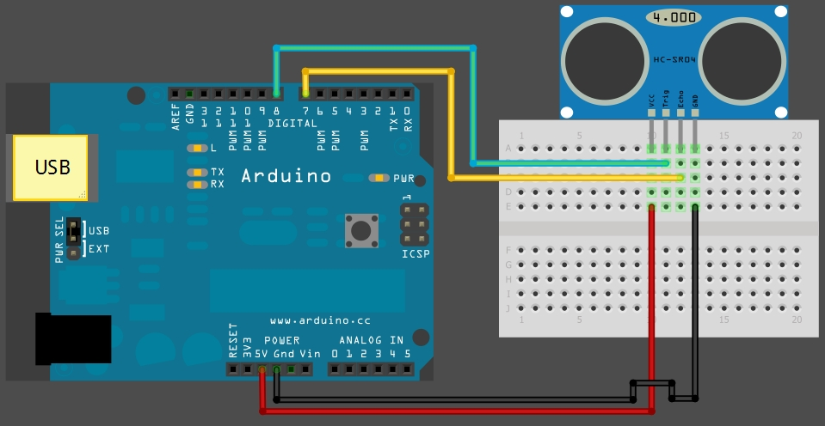
Connections for the Ultrasonic Range Finder
Connect your ultrasonic sensor as shown in the image. Switch the echo and trig pins if needed according to your preference.

Slide 8
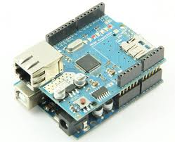
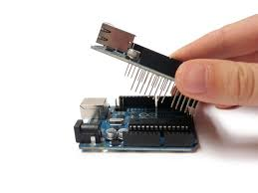
Architecture
The Arduino is a microcontroller that can be programmed to perform the particular tasks that you want it to do. In order to control the ultrasonic sensor via internet, there should be an Ethernet shield mounted on top of it.

Slide 9
View Data from Anywhere!
You would want to access it from anywhere, right?
So ,in order to do that we will have to create a server which can be accessed from anywhere. The Arduino Uno has only 32KB of program memory. So it is not powerful enough to contain html script.
So I downloaded Xampp which is a software that supports server side programming.

Slide 10
Servers and Clients
Server - Acts as a server which can serve millions of people.(can access data from anywhere)
Client - Acts as a usual client which can receive the data from a server.

Slide 11
Xampp
Xampp supports all server side programming languages that include:
•PHP •SQL •ASPX •ASP •.NET •RUBY
One must have a text editor in order to code. (for example Notepad++, Sublime etc.)

Slide 12
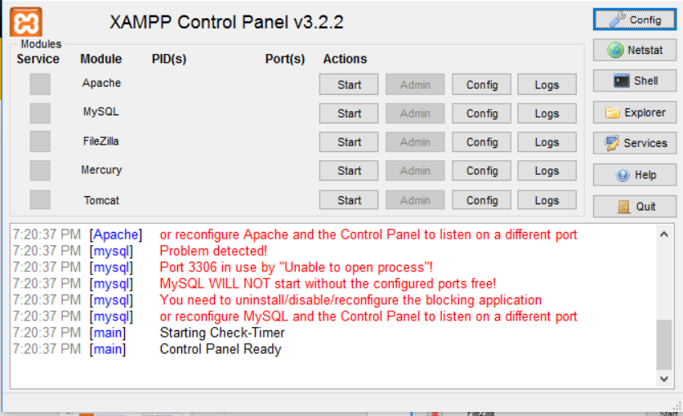
Xampp Control Panel
This is the xampp control panel where one can enable server side programming and the sql database.
Apache uses port 80.So, no program should be running on port 80.
MySQL uses port number 3306. So,no program must be running on that port too.

Slide 13
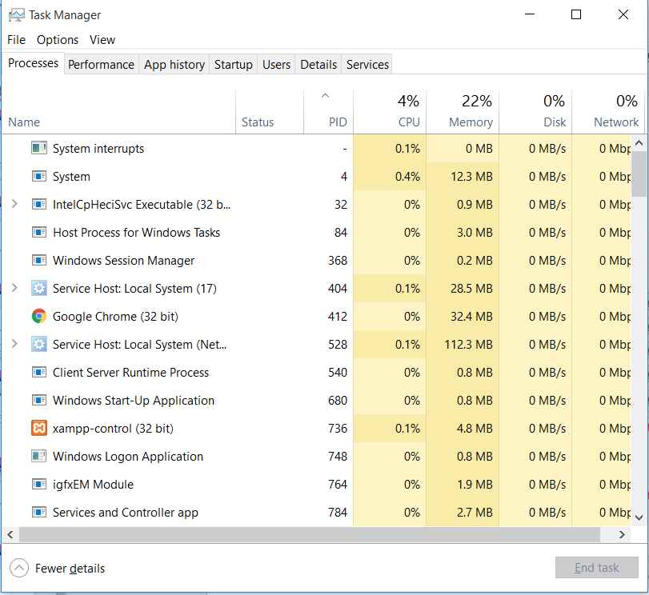
Xampp not Working?
If xampp does not work, then go to task manager and check the ports. If there are any systems running on port 80 or port 3306, then there will be a clash between them. So you will need to stop those ports for apache and MySQL to function.

Slide 14
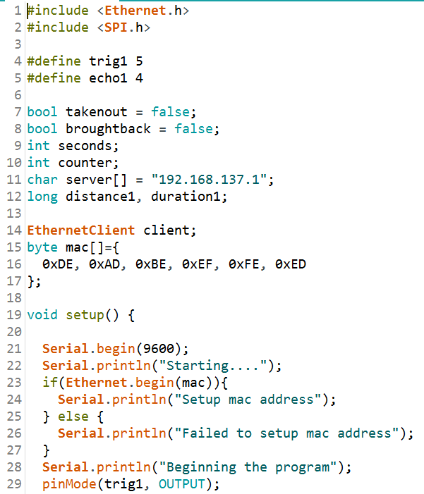
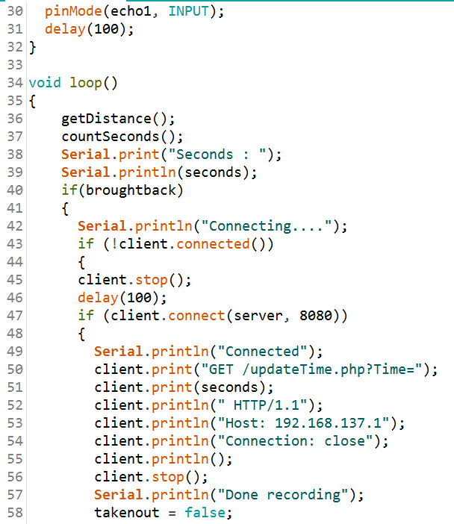
Arduino Code – Part 1

Slide 15
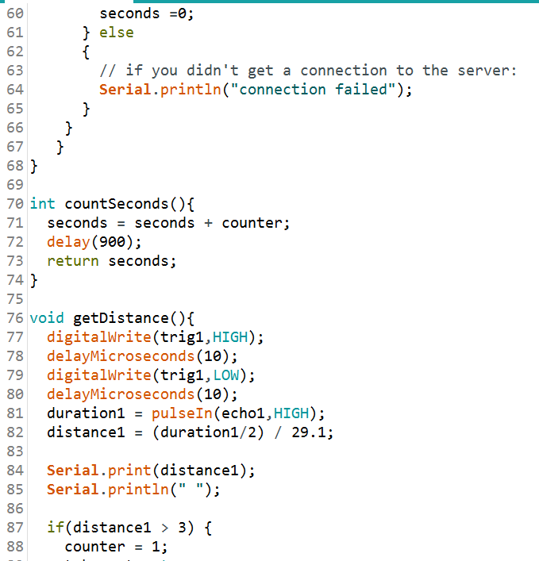
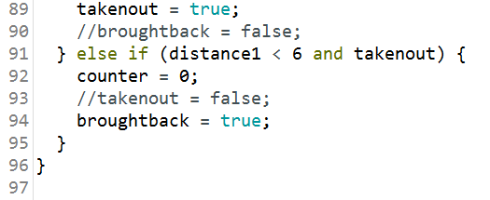
Arduino Code Part 2

Slide 16
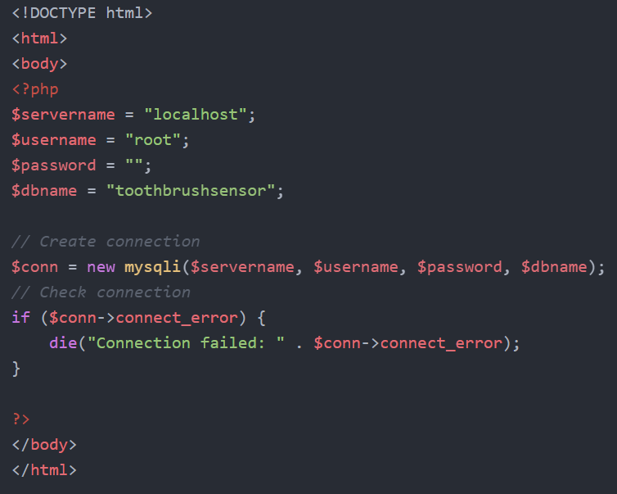
SQL Connection

Slide 17
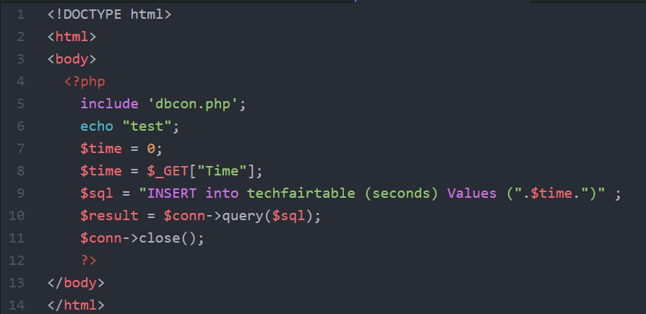
Update Time

Slide 18
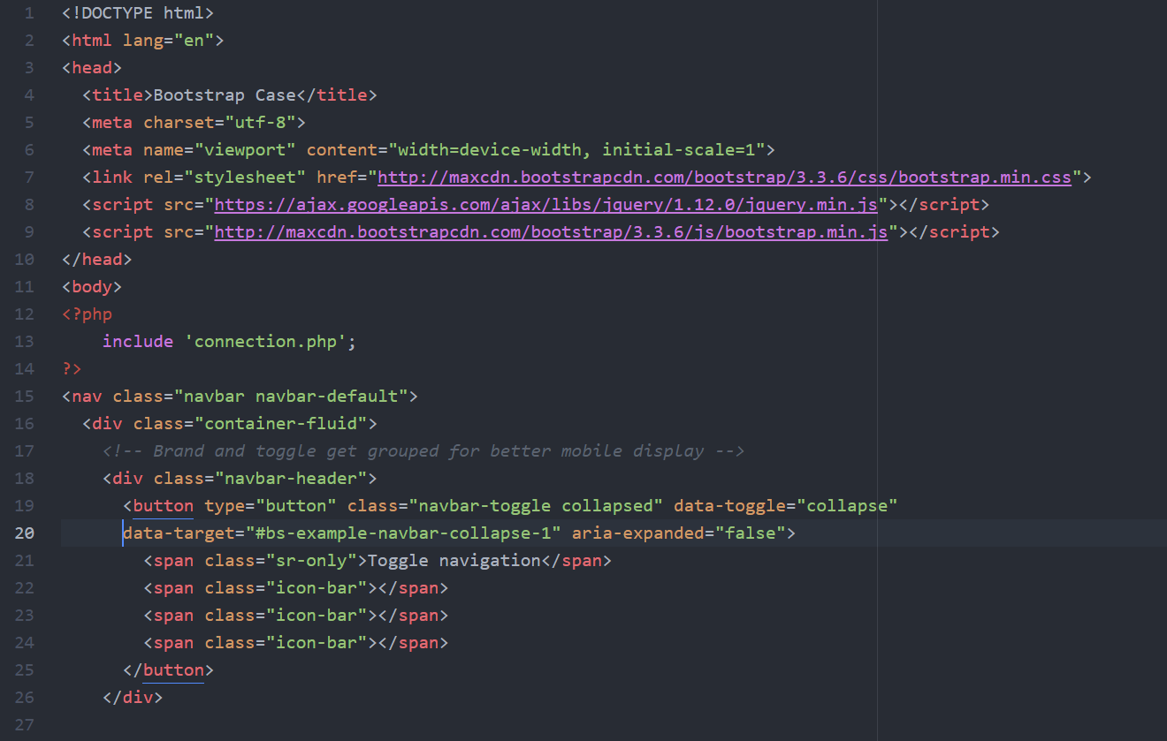
Web Page home screen – Part 1

Slide 19
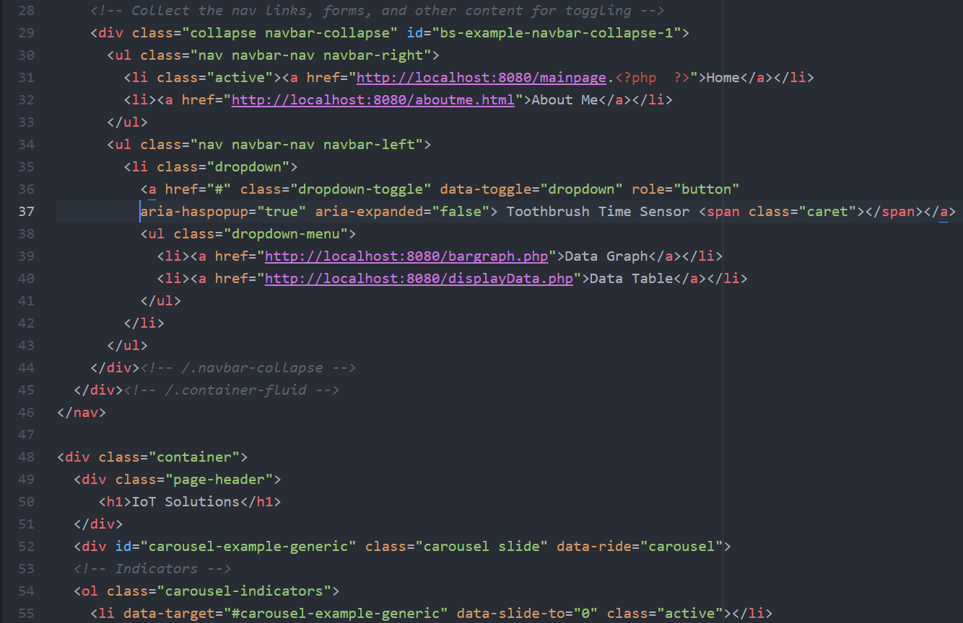
Web Page home screen – Part 2

Slide 20
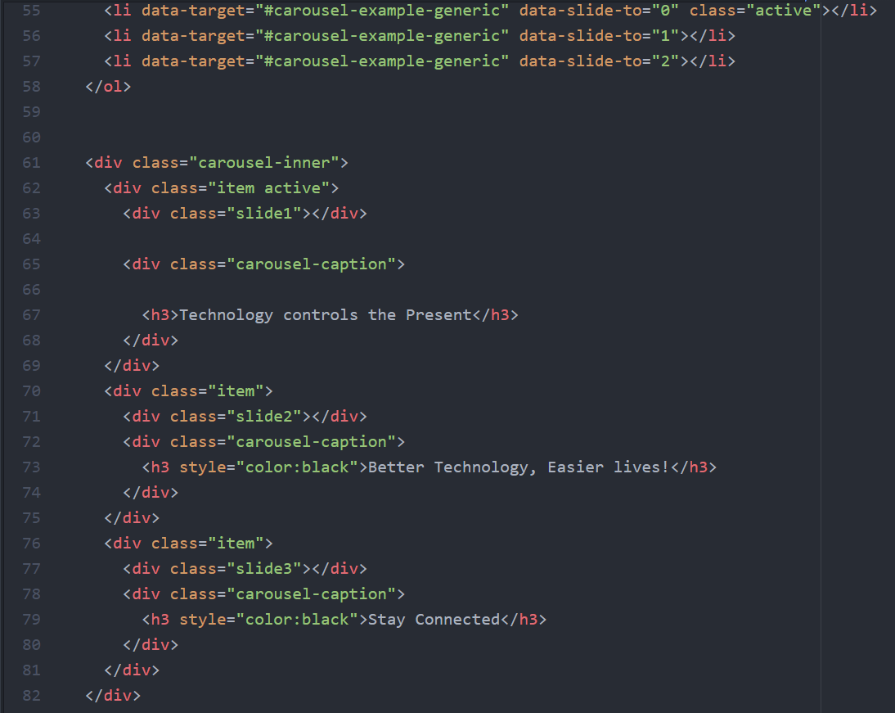
Web Page home screen – Part 3

Slide 21
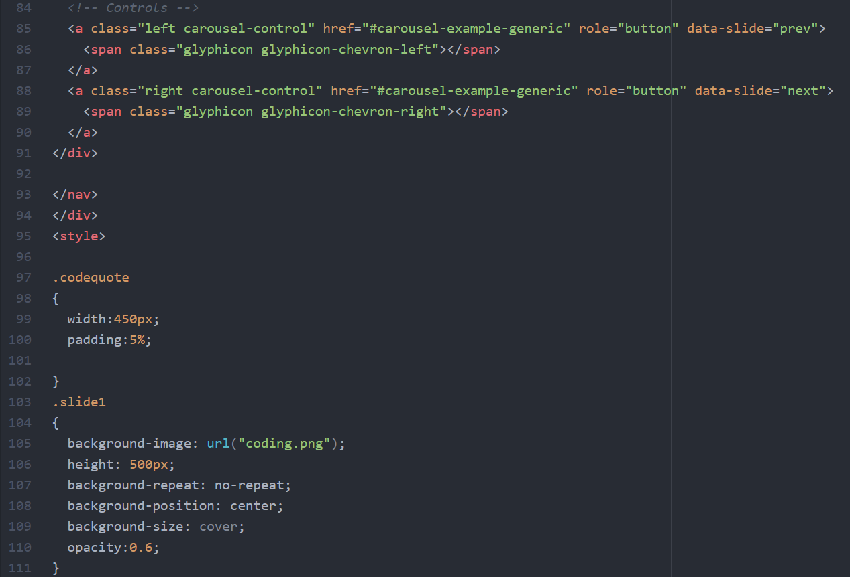
Web Page home screen – Part 4

Slide 22
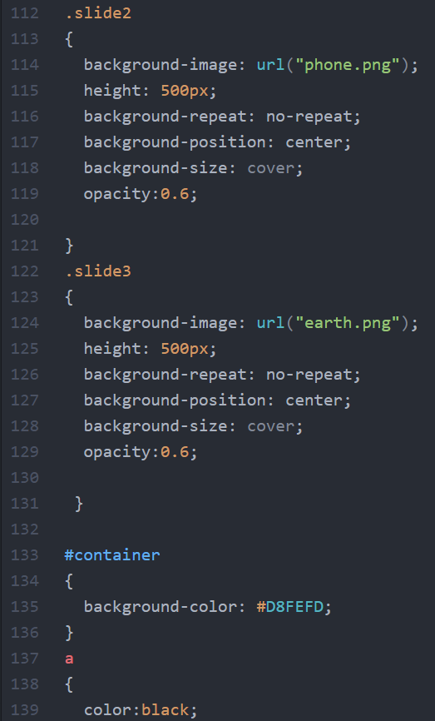
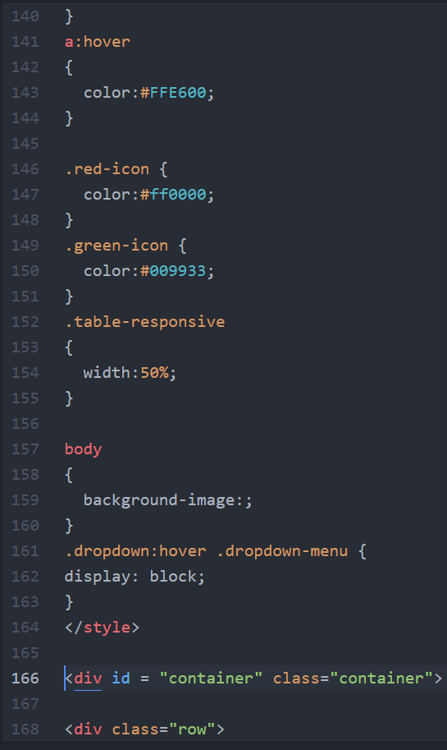
Web Page home screen – Part 5

Slide 23
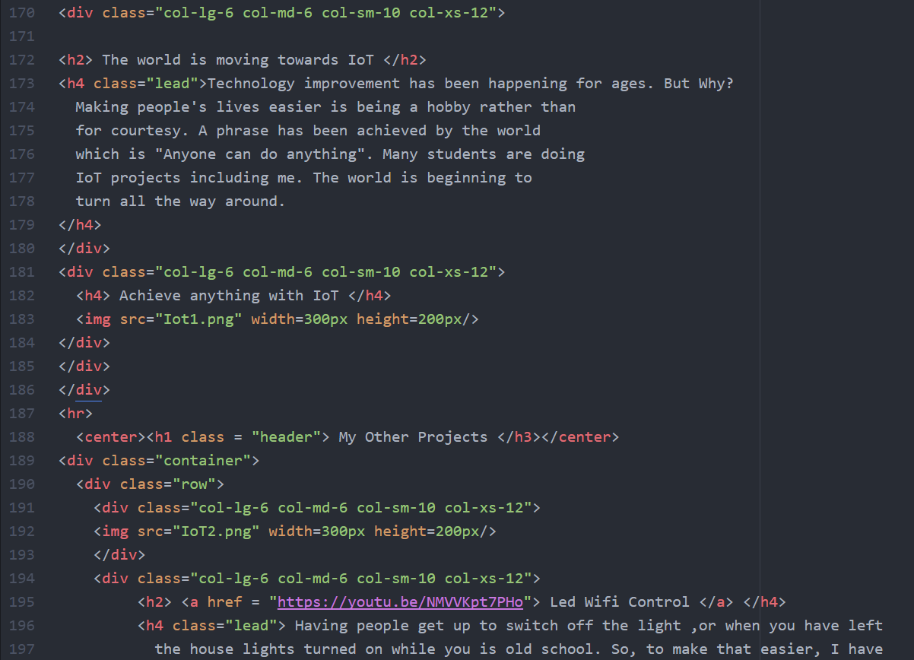
Web Page home screen – Part 6

Slide 24
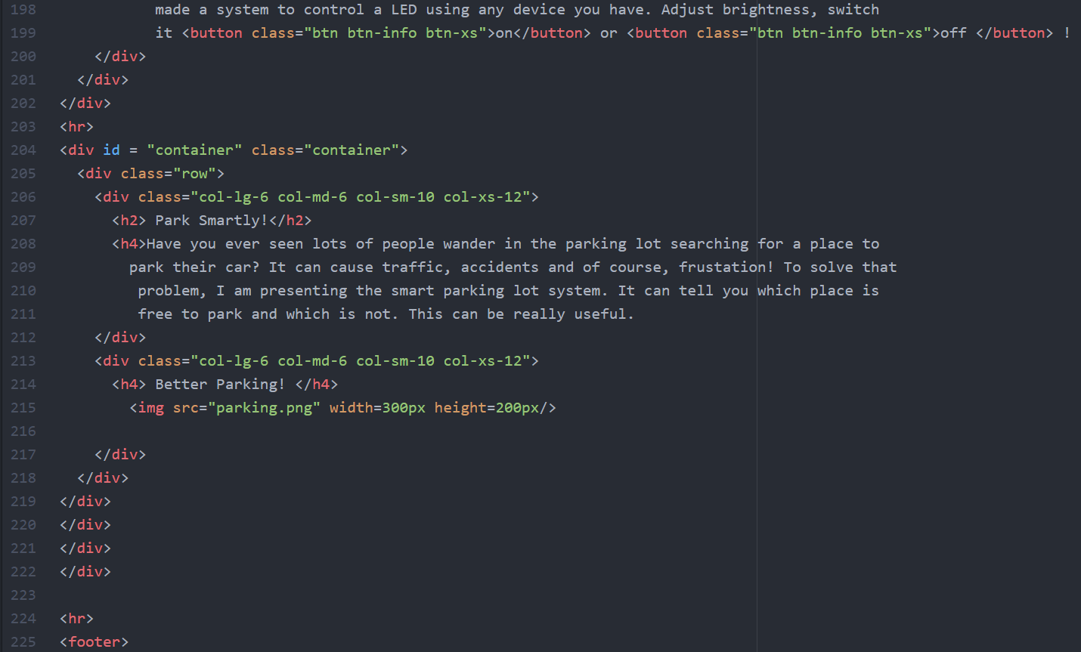
Web Page home screen – Part 7

Slide 25
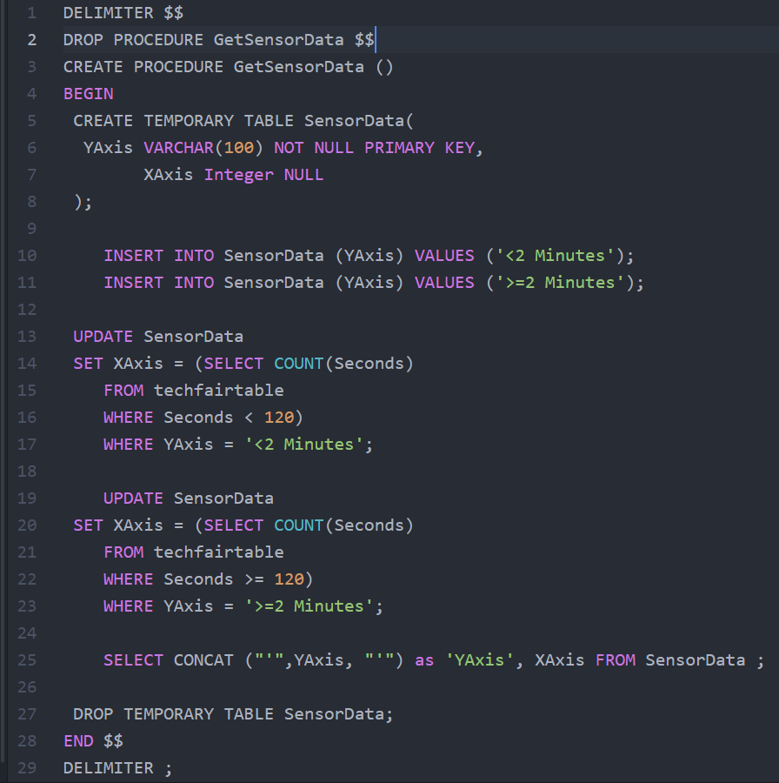
SQL Bar graph Procedure

Slide 26
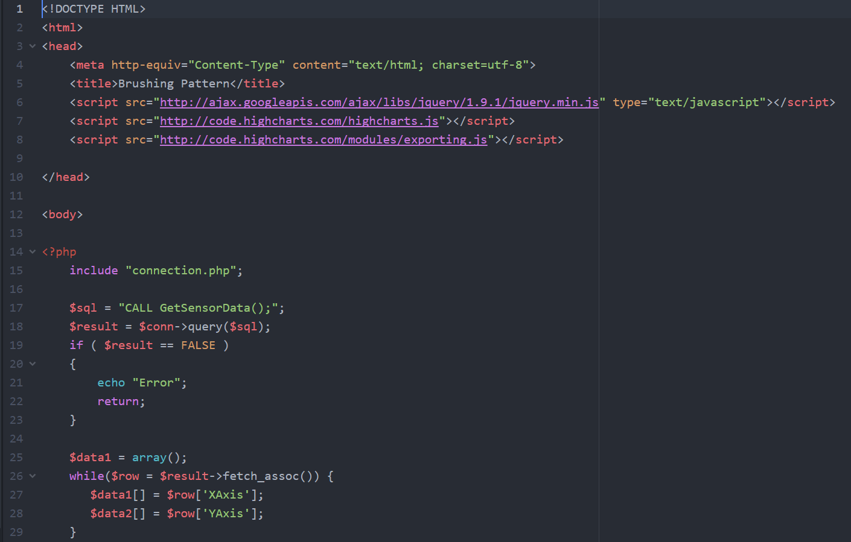
Bar graph JS – Part 1
These lines of code include a specific framework called HIGHCHARTS JS. This JS framework enables the usage of graphs and other statistical content.

Slide 27
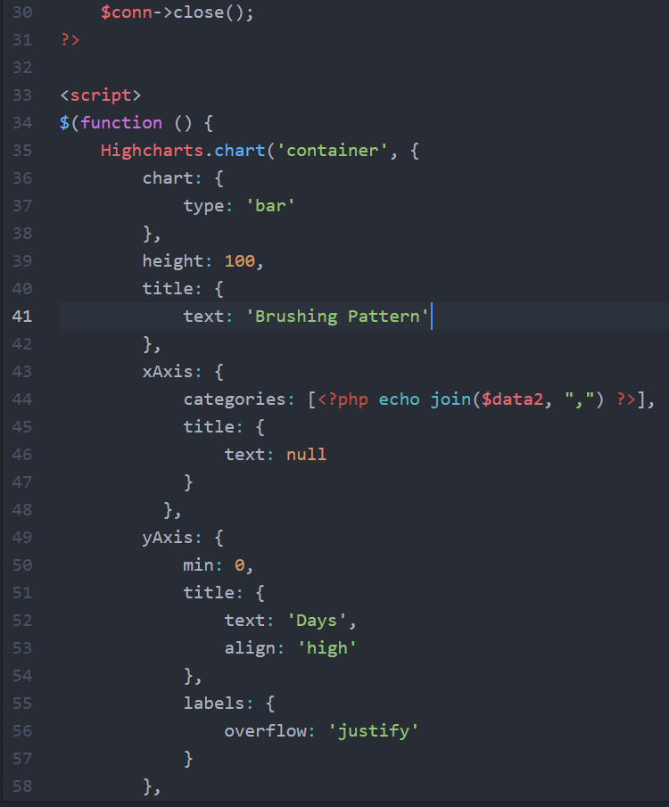
Bar graph JS – Part 2

Slide 28
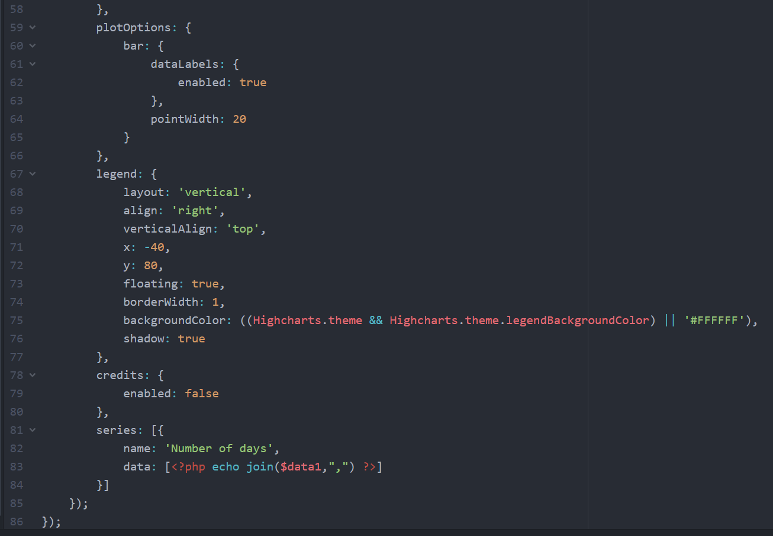
Bar graph JS – Part 3

Slide 29
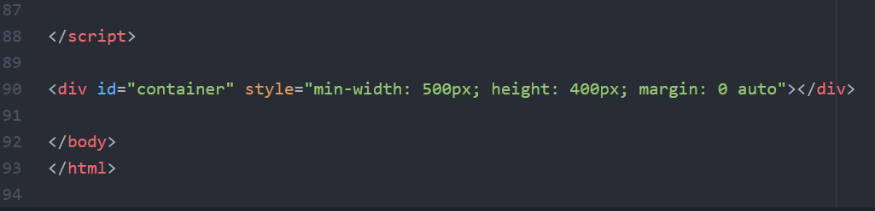
Bar graph JS – Part 4

Slide 30
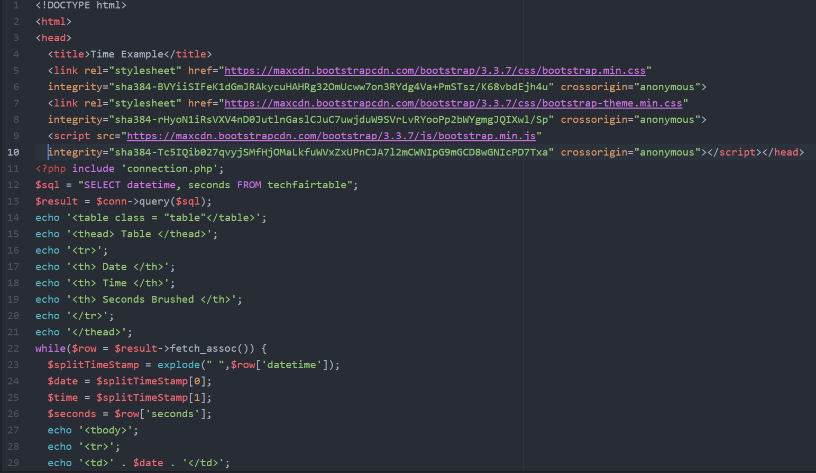
Finally! Displaying the Data – Part 1

Slide 31
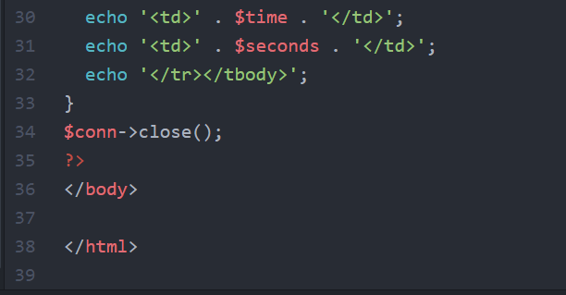
Finally! Displaying the Data – Part 2

Slide 32
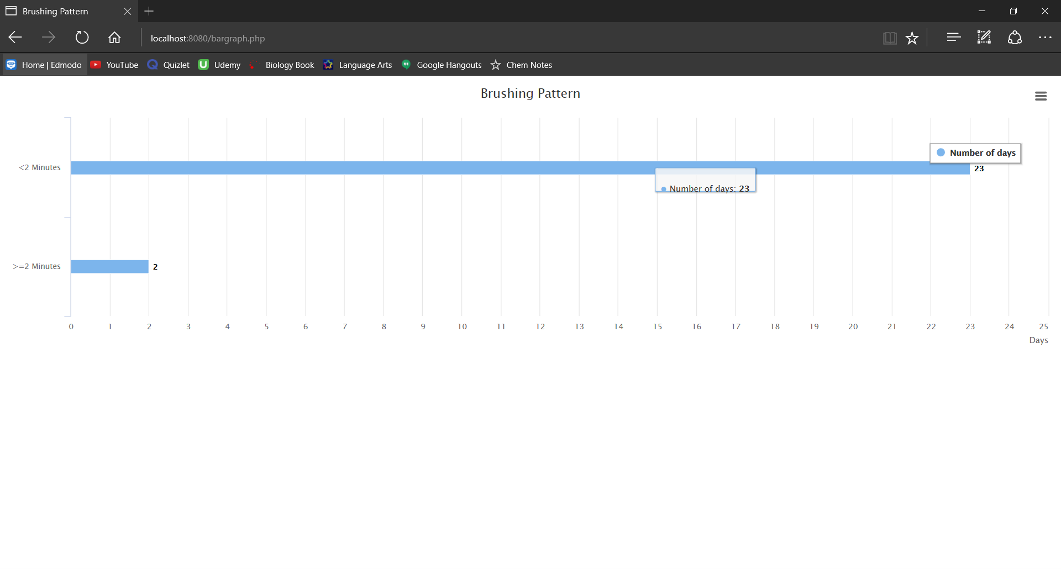
Snippets of The Webpage – Part 1

Slide 33
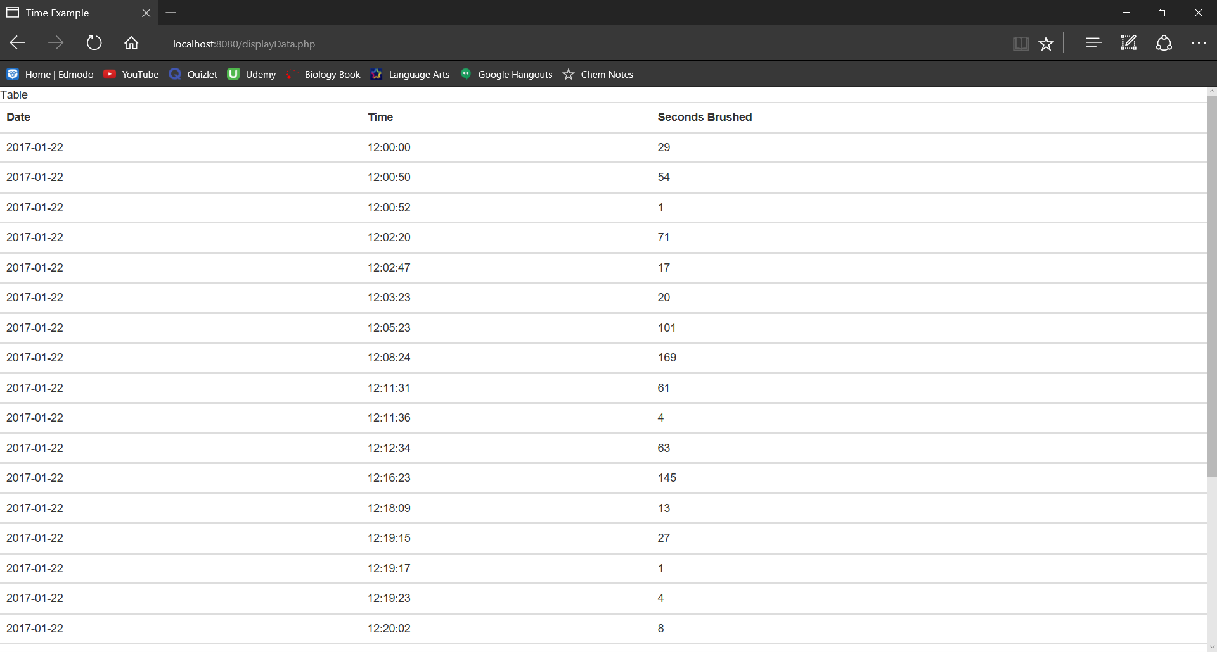
Snippets of the Webpage – Part 2

Slide 34
What next?
If the Ethernet Board is not working, then:
1.Reset the ARDUINO BOARD.
2.Reset the ETHERNET BOARD.
3.Uncheck Sharing option under WIFI Properties.
4.Check the sharing option back.
5.Disable WIFI.
6.Enable WIFI.
7.Disable Ethernet.
8.Enable Ethernet.
9.Run IP Address Printer. (Should print out a valid address)
Now that all the code is written and run, we need to test everything and re-run the code to test that everything is running properly.
There might be several bottlenecks, but there are several ways to fix them.
For instance, I faced a problem where the Ethernet shield would not connect properly. Here is what I did:

Slide 35
Benefits
The main purpose of this project is to calculate the time taken by a person to brush his/her teeth. This will help us manipulate increasing or decreasing brushing times.
This is a great example of a helpful IOT project.

Slide 36
What is my motive? More Improvements?
My motive is to create applications that serve a purpose in real life using technology and programming.
If given more time, it is certain that I would improve the sensitivity and add more statistical data to it.
Many other external application like SMS and Email can also be added, for example: If a person had brushed for less than 2 minutes, then it would send an SMS straight to his / her parent.
A mobile app can also be created to get access to the data instead of a website.

Slide 37
public static void main (String args[]){ print(“Thank you!”); }

